Slide 1
Flexible Matrix Multiplication Accelerator with High-Level synthesis
Final Project Team2
吳承哲 許睿哲 石思宇

Slide 2
Overview
Introduction
System architecture and block diagram
Code Description
Experimental results and analysis
Reference

Slide 3
Introduction
Where is matrix multiplication used?
real-time digital processings, network control systems, process control and real-time image processing
What concern engineers the most when it comes to hardware designs?
With the growing technology gap between computation and memory speeds, scientist and engineers aim to minimize data movement
Research focusing on multiprocessor parallel computing for speed on one side, and on achieving parallel computing inside an accelerator to optimize overall computational performance
Our principal goal doing this project?
Replicate the design of last year final’s project, which is a scalable matrix multiplication accelerator, in order to find the cause for poor performance shown when the input matrix size is not a multiple of the tile size of the kernel

Slide 4
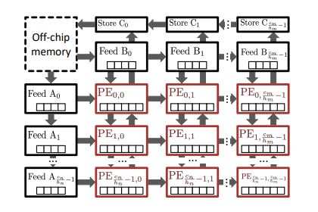
Brief Description about Systolic Array
Made of a grid of processing elements in regular pattern
2D array of PEs tightly coupled and communicate with their neighboring PEs
Principal objective of using such architecture is to efficiently implement algorithms involving regular and repetitive computation such as matrix multiplication and convolution

Slide 5
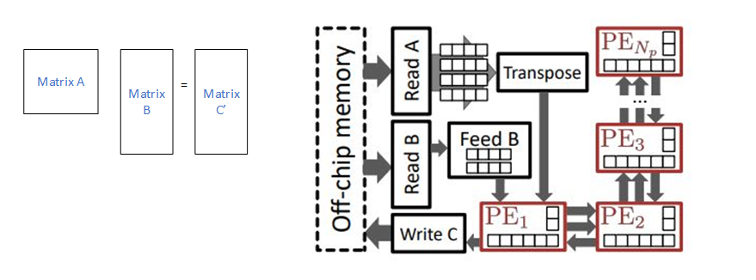
System Architecture
Consist of a host, a high-bandwith memory and an FPGA
The kernel on the FPGA is made of 1D array PEs instead of 2D systolic array because author aimed to map various interconnect structures and non-uniform setups.
The step of the system
Initialize OpenCL
Read matrices A&B
Execute Kernel
Write product matrix C
Compute golden result on host
Compare the results

Slide 6
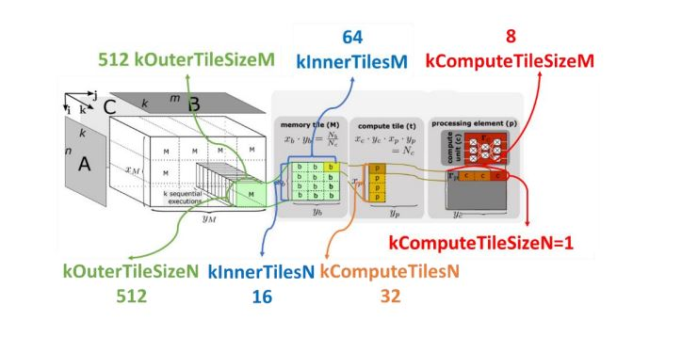
Detailed Block Diagram 1
The kernel is partitioned into multiple tiles
Outer tiles are further subdivided into inner tiles
Each inner tile is divided into processing elements which are made of 1D array of compute unite
How are the size given?

Slide 7
Detailed Block Diagram 2
DMM_DATA_TYPE: Specifies the data type of the input/output matrices, such as float, int, double, etc.
DMM_PARALLELISM_N: Represents the number of processing elements (PEs) within an inner tile that will run in parallel. This corresponds to kComputeTilesN in Figure 2.
DMM_PARALLELISM_M: Indicates the size of a processing element (PE), or the number of compute units it possesses. This aligns with kComputeTileSizeM in Figure 2.
DMM_MEMORY_TILE_SIZE_N: Refers to the size of an outer tile in the N dimension, denoted as kOuterTileSizeN.
DMM_MEMORY_TILE_SIZE_M: Denotes the size of an outer tile in the M dimension, represented as kOuterTileSizeM.
kInnerTilesN is obtained by dividing the kOuterTileSizeN by kComputeTileSizeM.
kInnerTilesM is obtained by dividing the kOuterTileSizeM by kComputeTilesN.

Slide 8
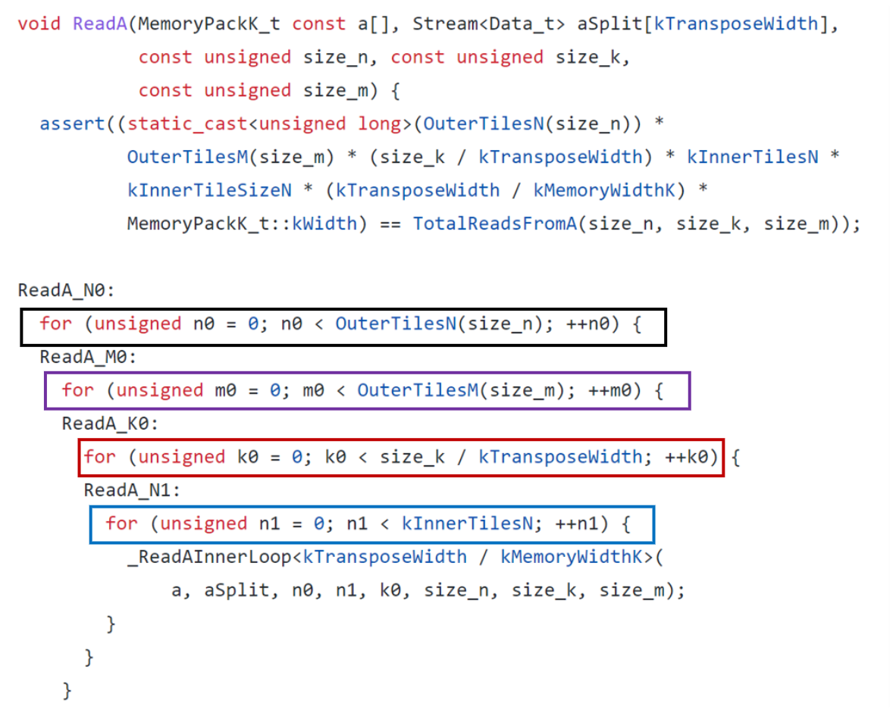
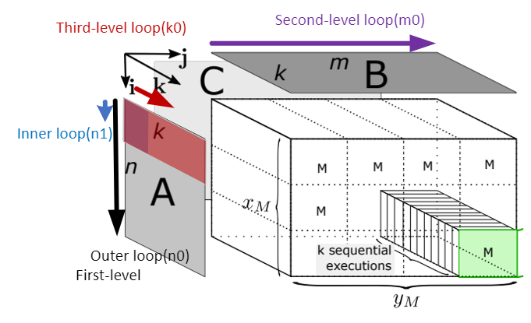
ReadA

Slide 9
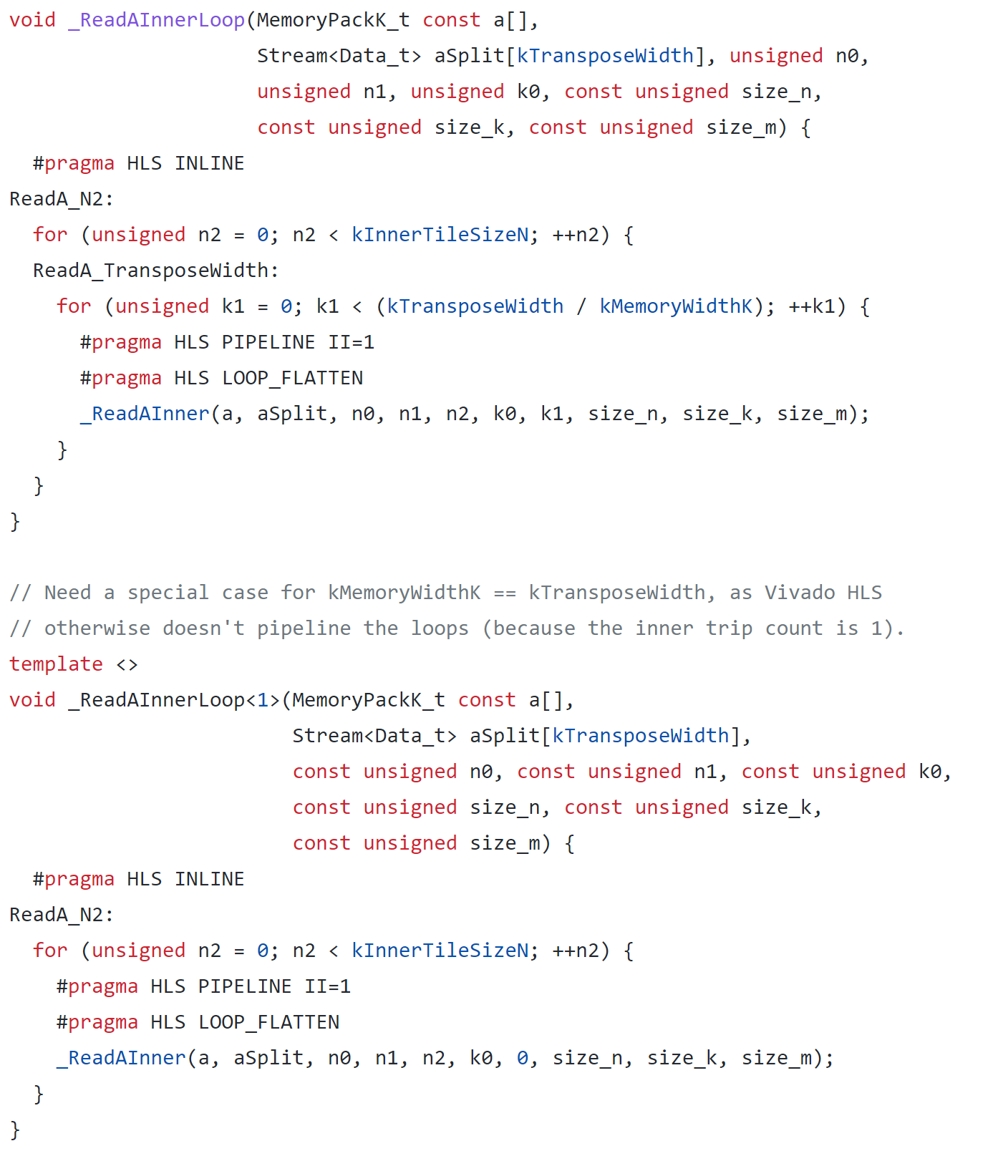
ReadA

Slide 10
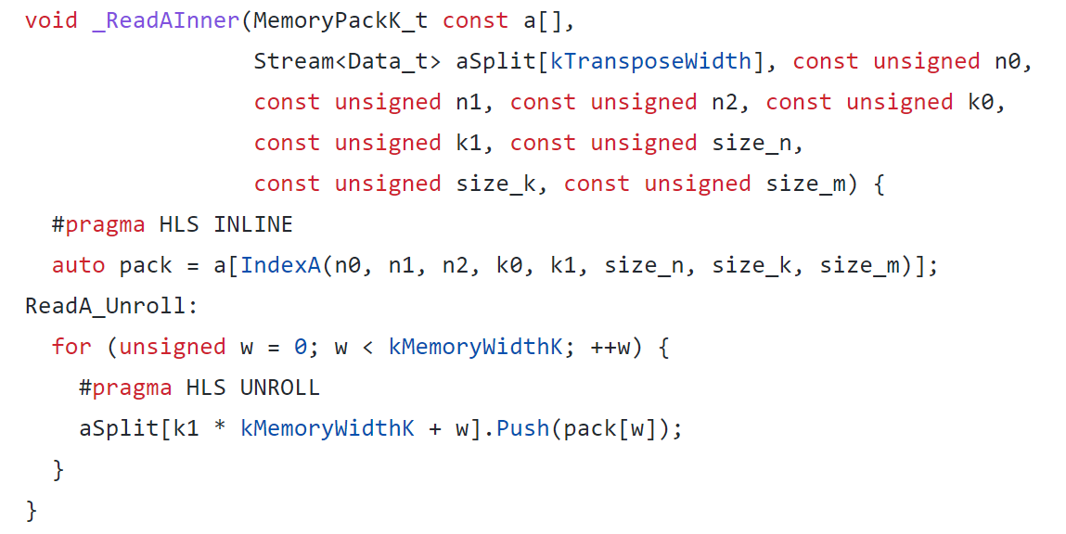
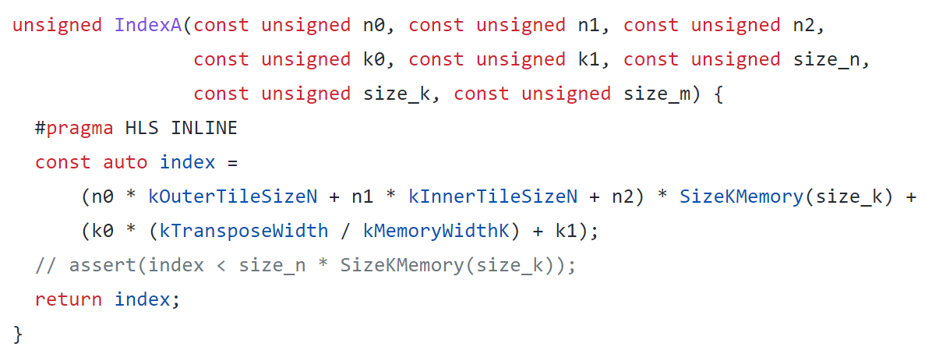
ReadA

Slide 11
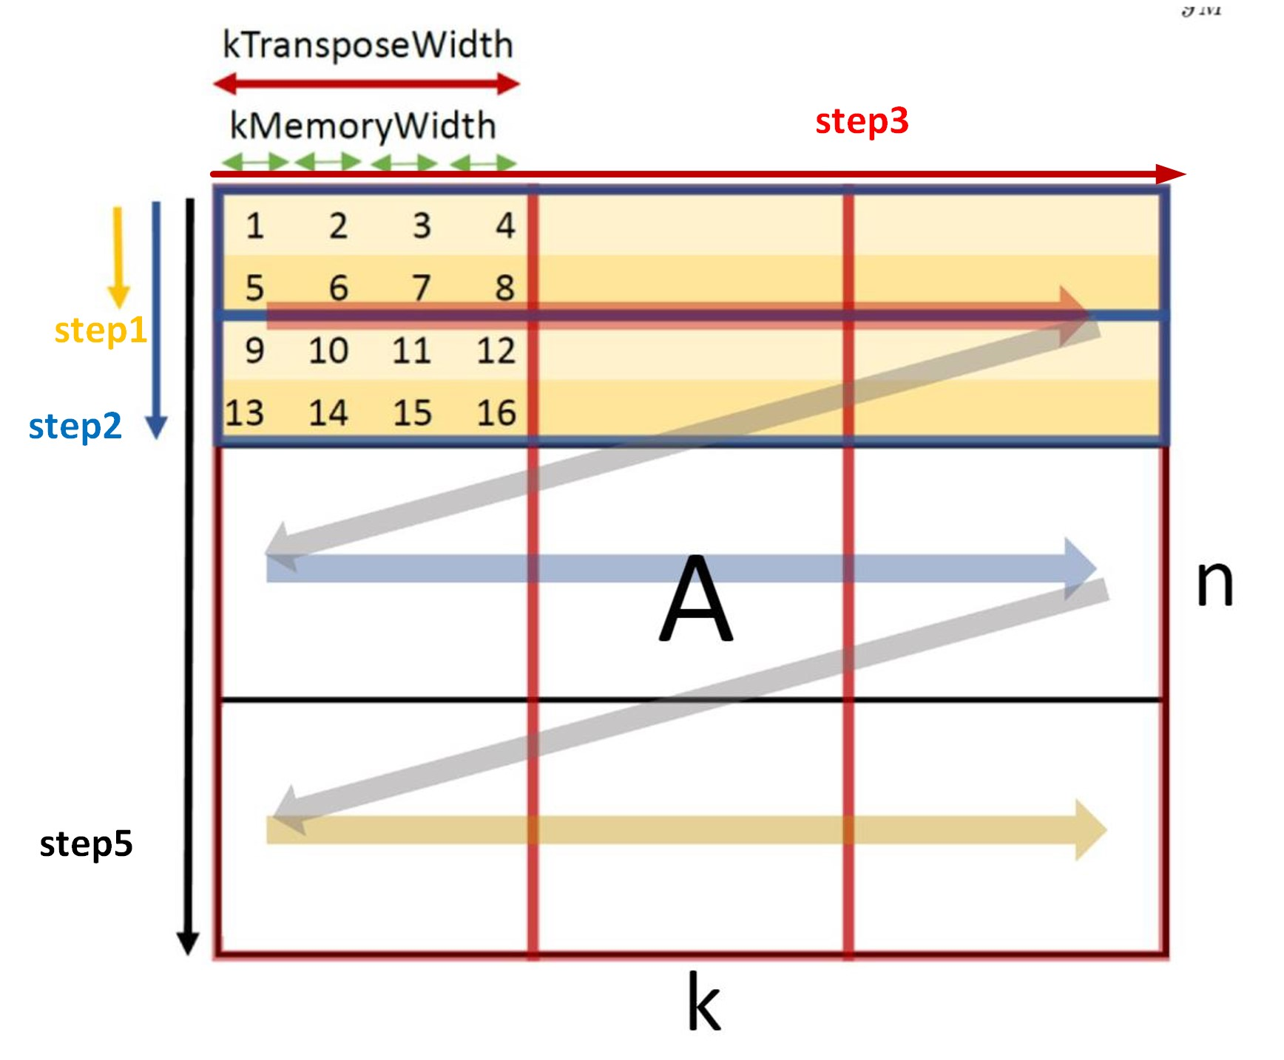
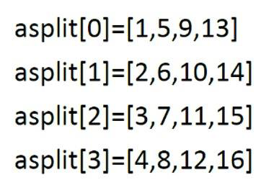
ReadA

Slide 12
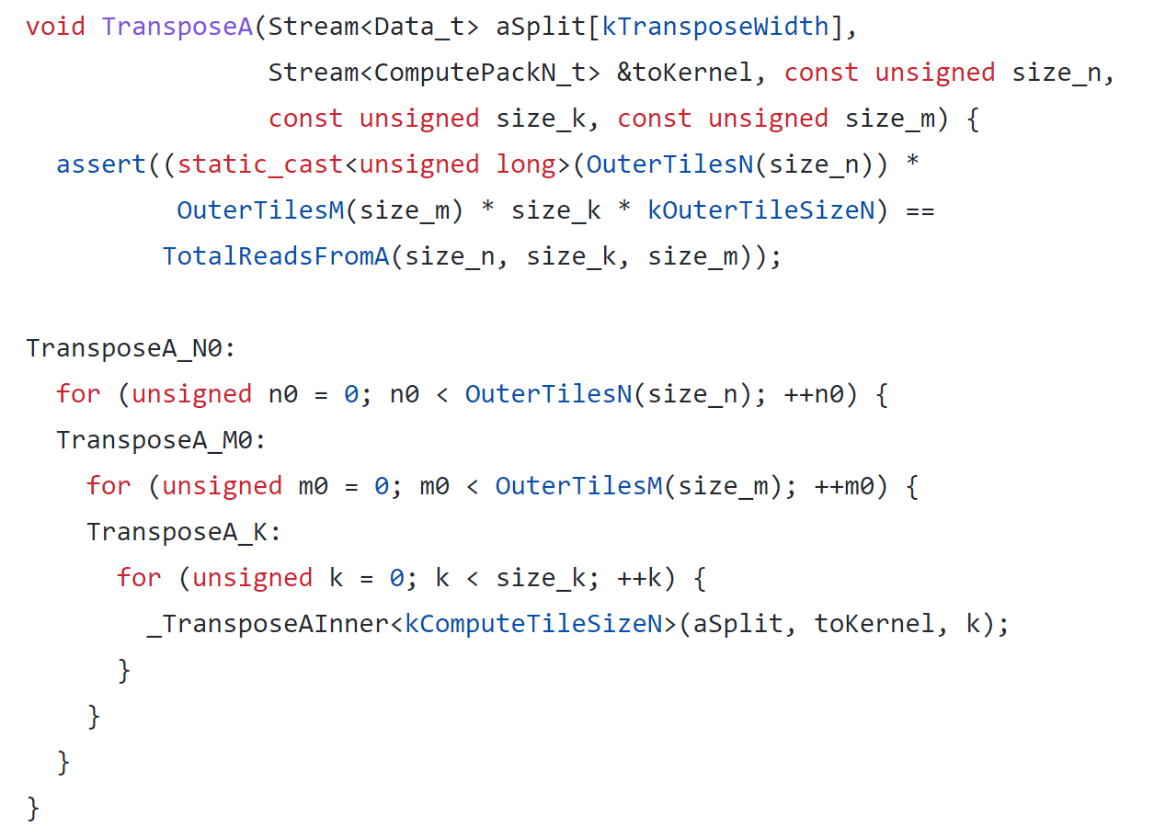
TransposeA

Slide 13
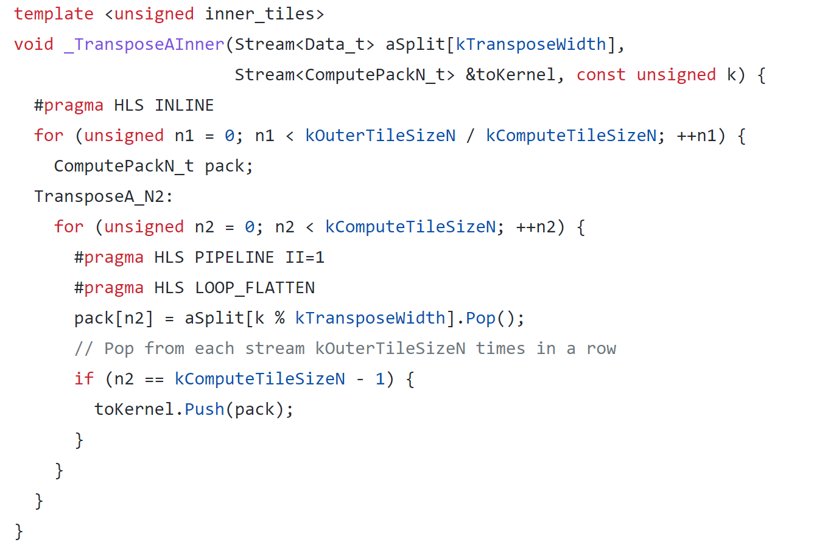
TransposeA

Slide 14
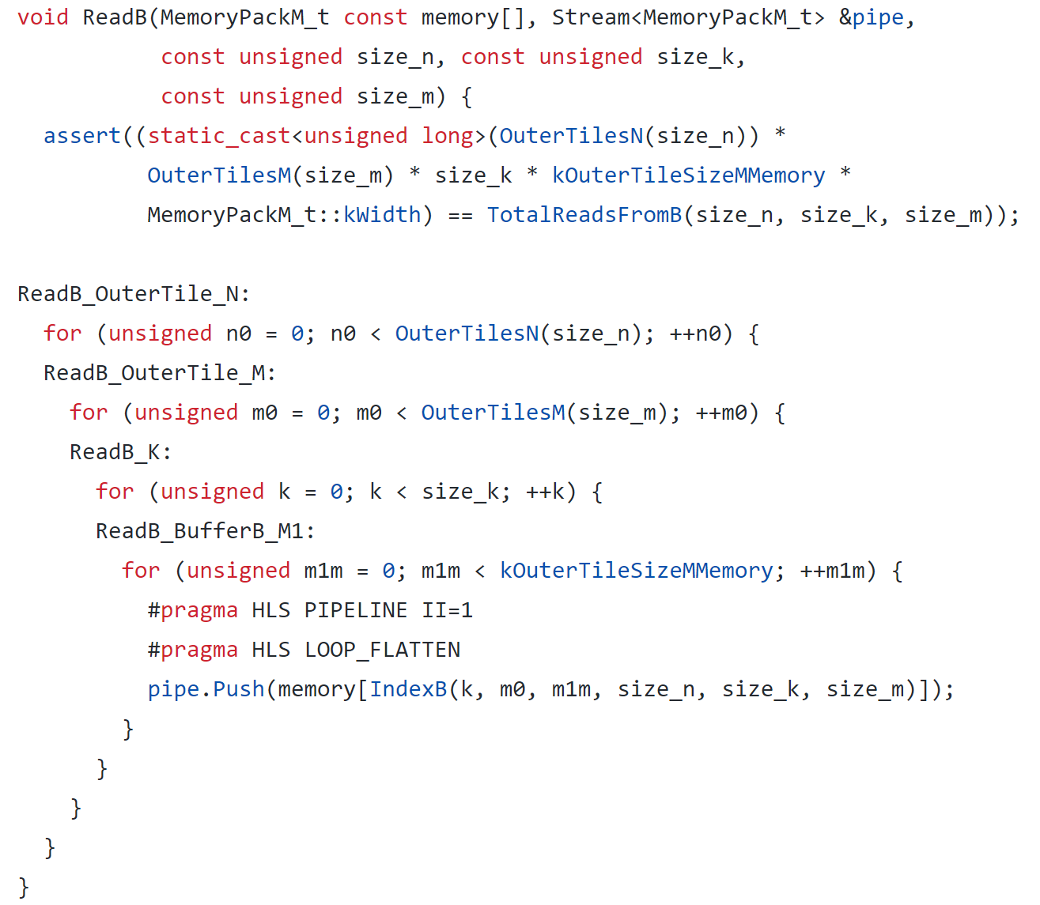
ReadB

Slide 15
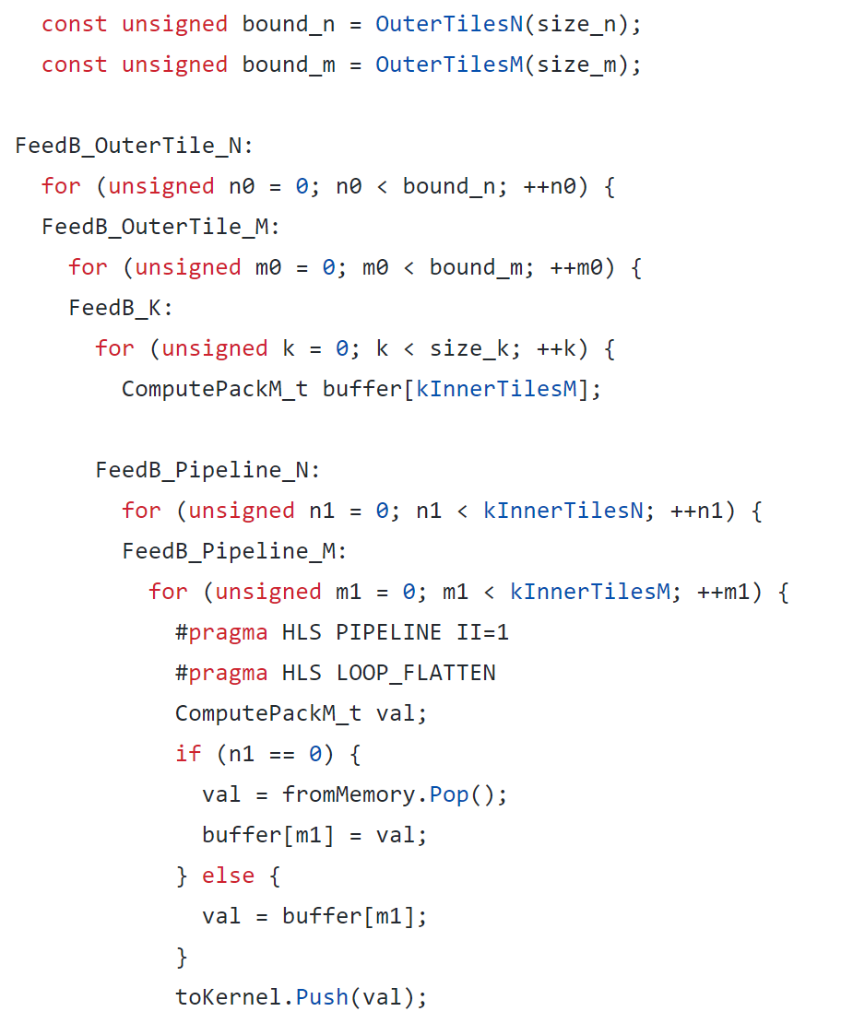
FeedB

Slide 16
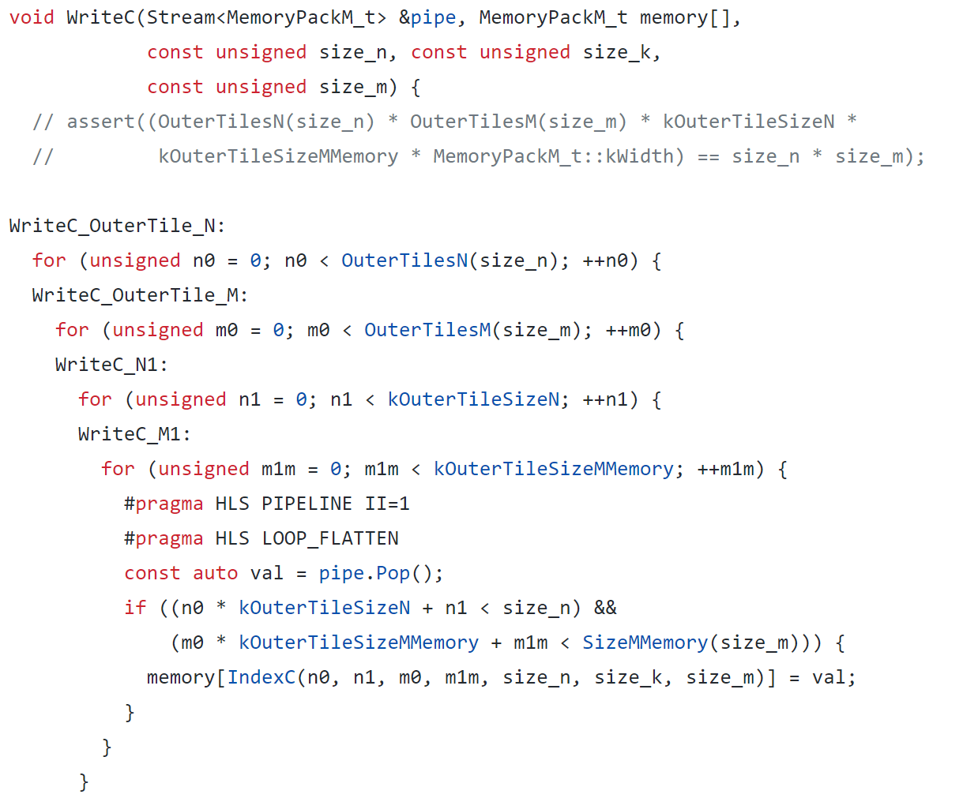
WriteC

Slide 17
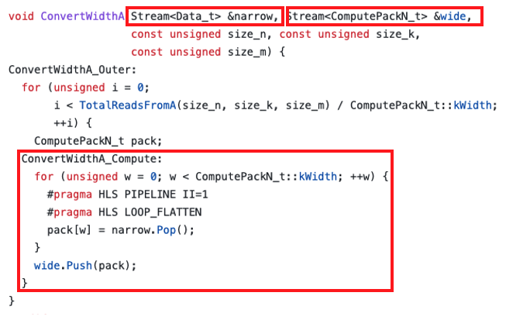
convert bitwidth

Slide 18
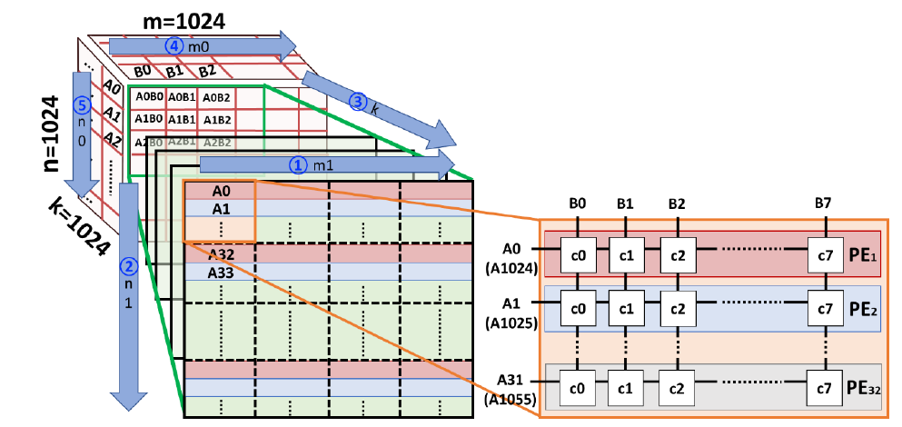
Dataflow

Slide 19
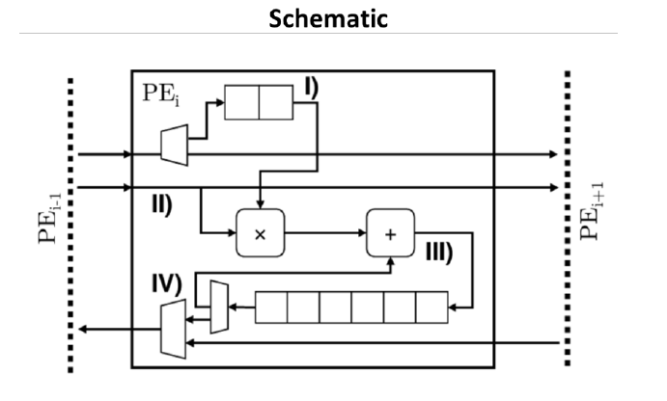
PE
總共分成5個部分
InitializeA.
PrepareA.
PrepareB.
Multiply and ADD.
WriteBack

Slide 20
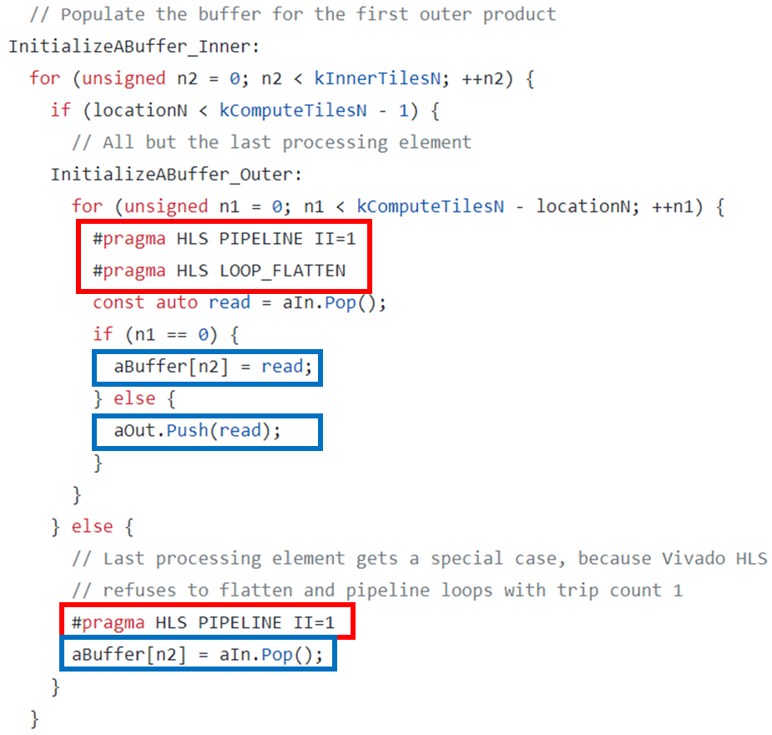
InitializeAbuffer
為了進行A矩陣的double buffer，先從aIn讀取此PE所需的資料到aBuffer中，再將不需要的資料送回aOut。

Slide 21
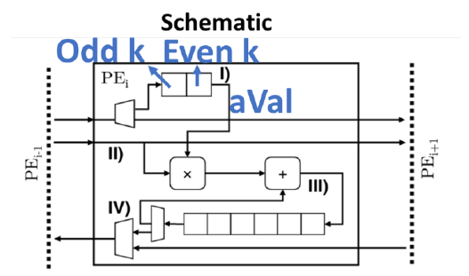
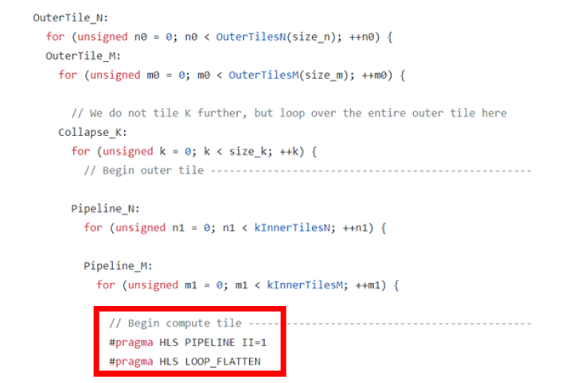
PreoareA

Slide 22
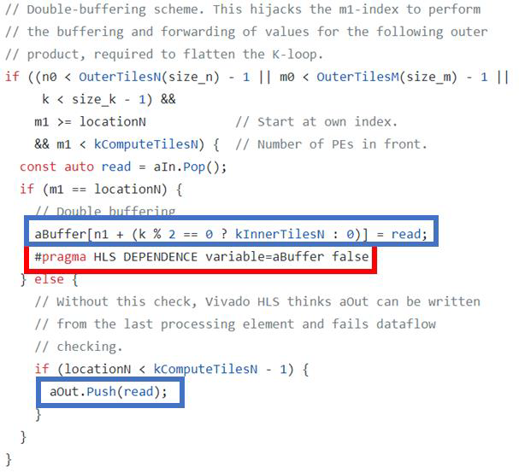
PrepareA

Slide 23
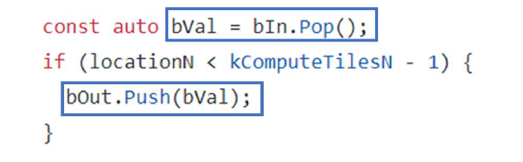
PrepareB

Slide 24
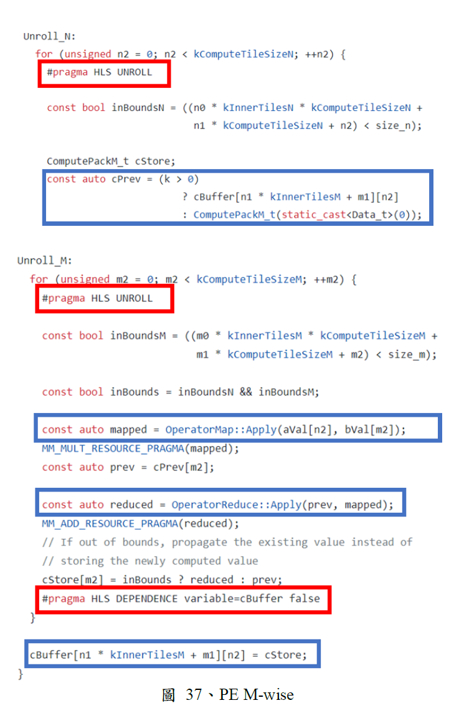
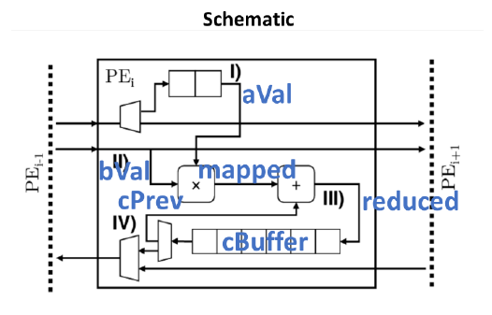
Multiply and Add

Slide 25
Multiply and Add

Slide 26
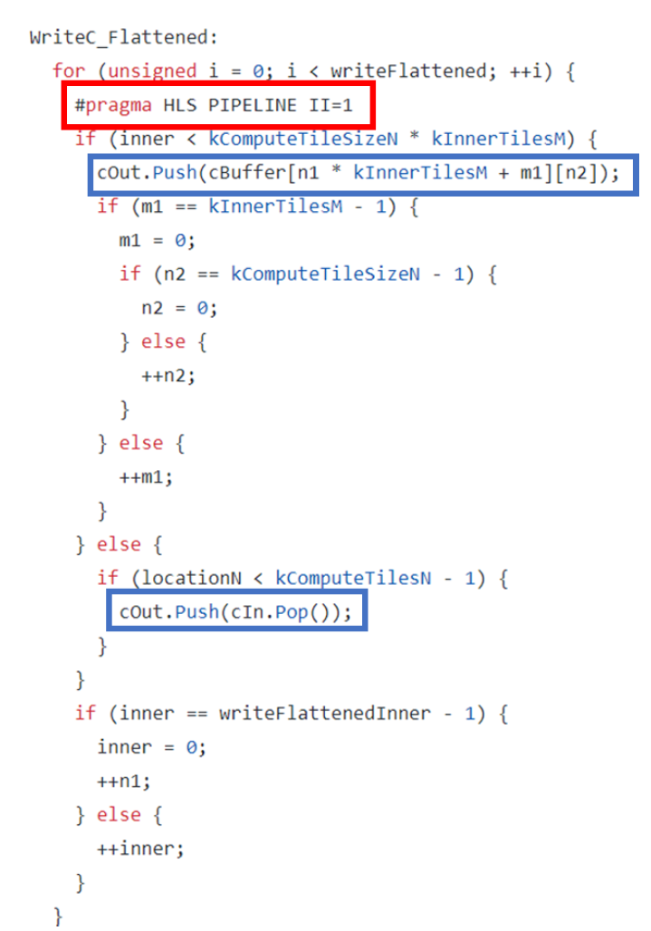
WriteBack

Slide 27
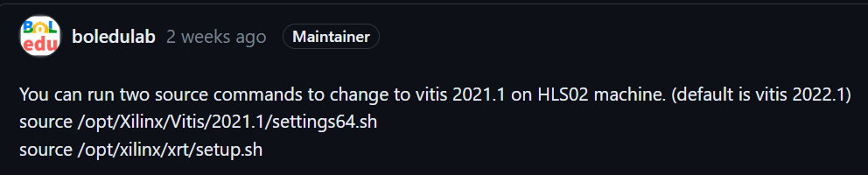
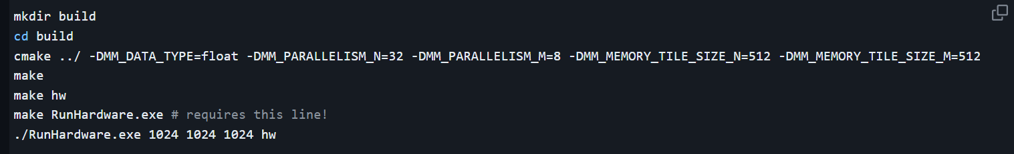
Experimental result and analysis

Slide 28
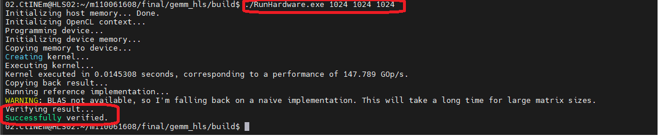
Result

Slide 29
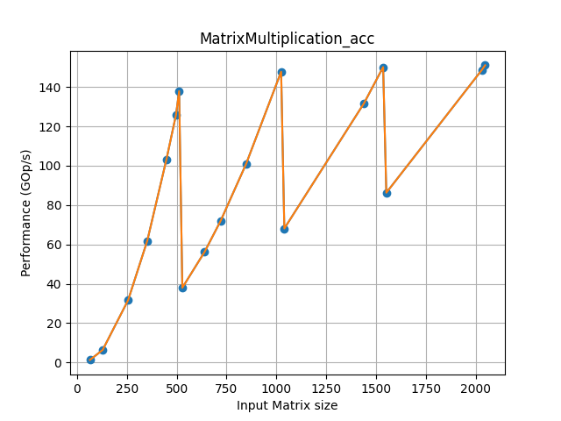
Different input matrix size
Drop!!

Slide 30
Hardware Emulation
mkdir build
cd build
cmake ../ -DMM_DATA_TYPE=float -DMM_PARALLELISM_N=8 -DMM_PARALLELISM_M=2 -DMM_MEMORY_TILE_SIZE_N=64 -DMM_MEMORY_TILE_SIZE_M=64
make
make hw_emu
./RunHardware.exe 64 64 64 hw_emu

Slide 31
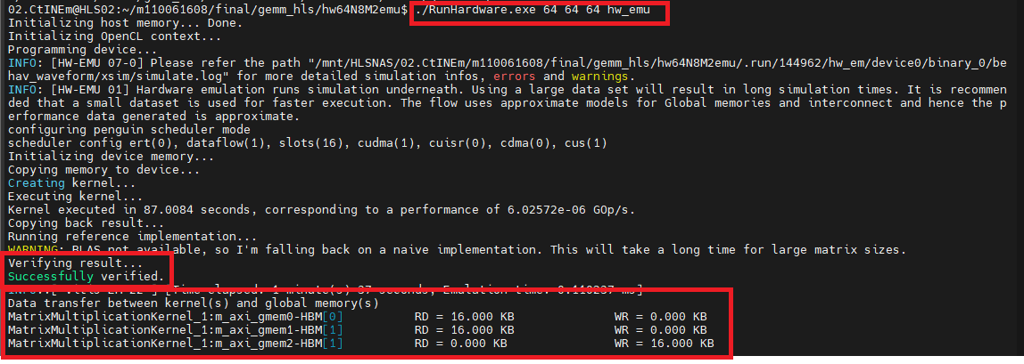
Emulation result

Slide 32
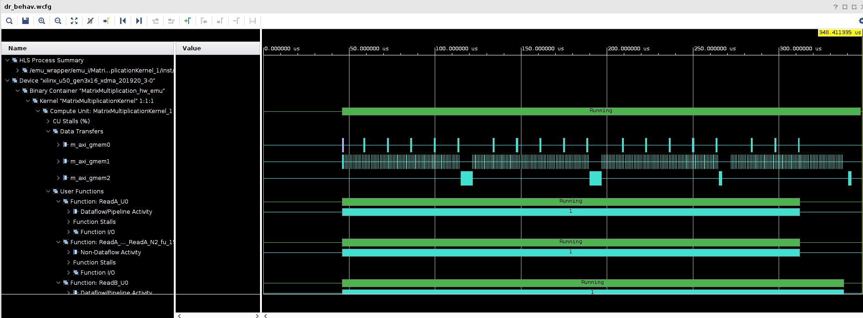
Hw_emu-Waveform(dr_behv.wcfg)

Slide 33
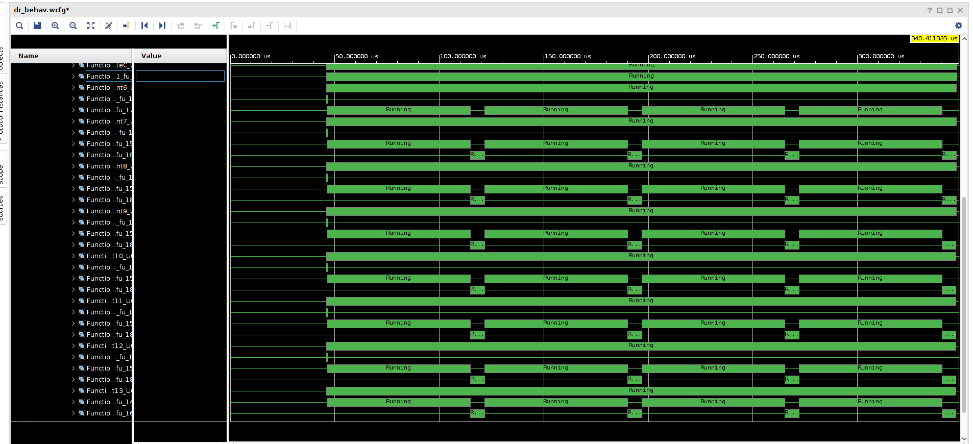

Slide 34
profile_kernel.csv - Function
ReadA,B
TransposeA
ConvertWidthB,C
FeedB
WriteC
PE
PARALLELISM_N = 16 , PARALLELISM_M = 4(Blue)
PARALLELISM_N = 8 , PARALLELISM_M = 2(Orange)

Slide 35
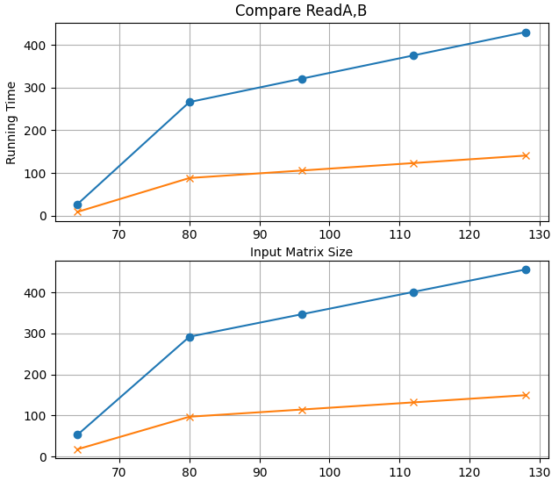
ReadA,B

Slide 36
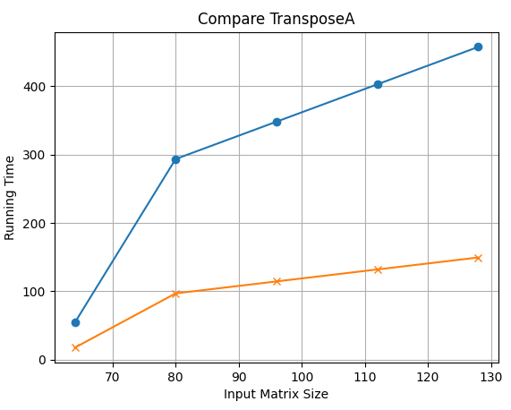
TransposeA

Slide 37
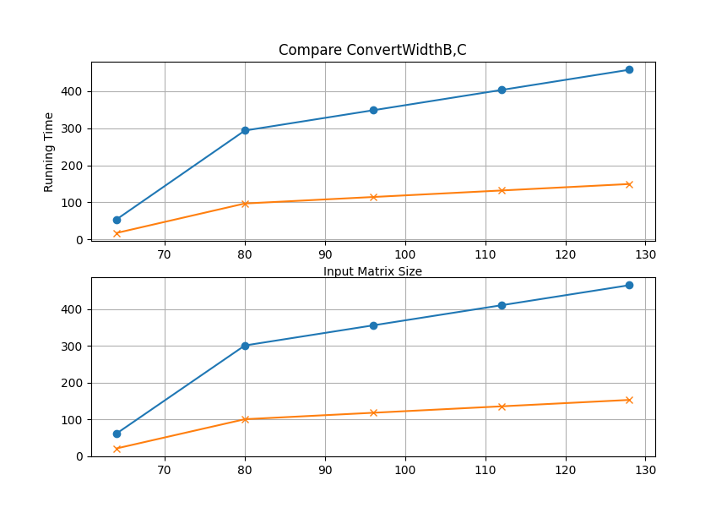
ConvertWidthB,C

Slide 38
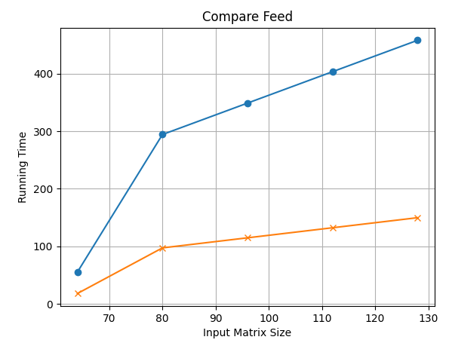
FeedB

Slide 39
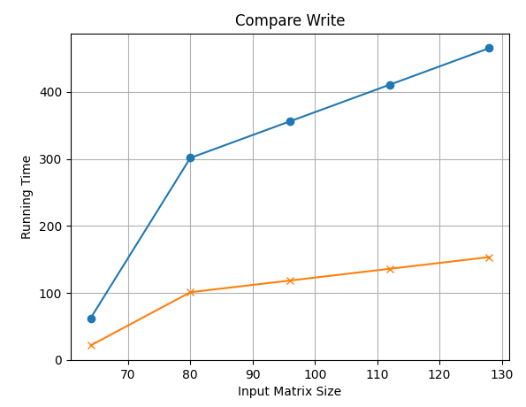
WriteC

Slide 40

PE

Slide 41
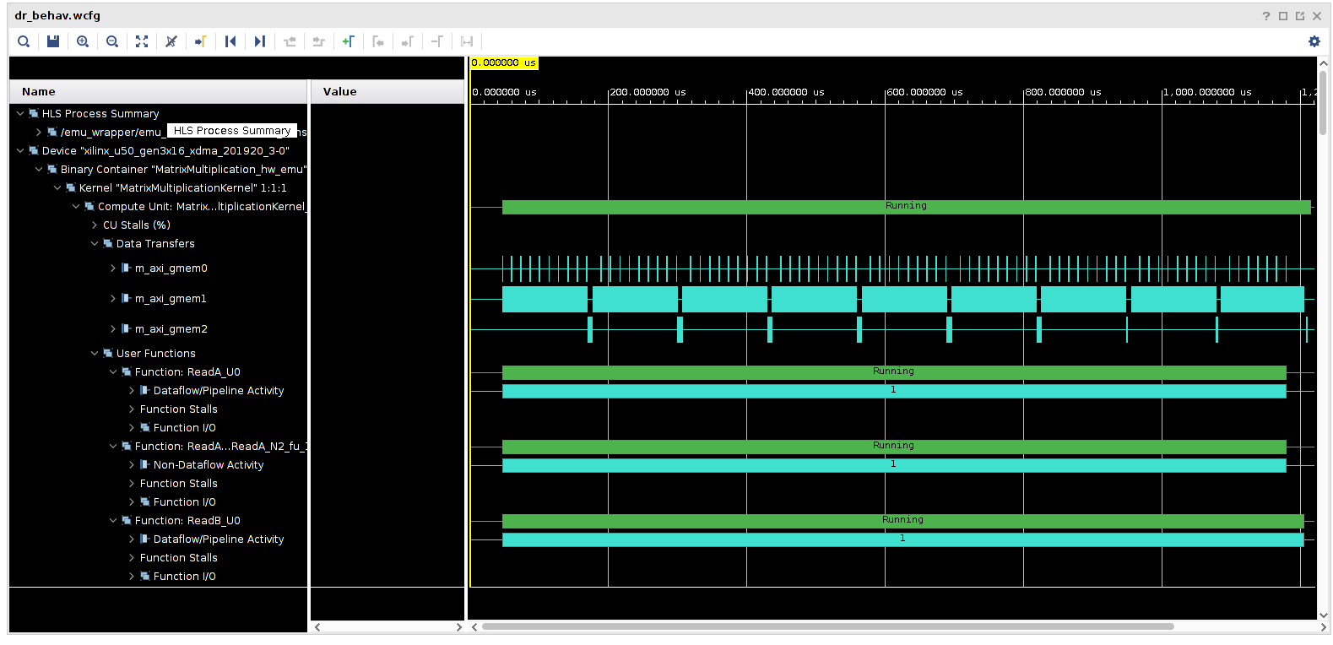
Different PE number - (N,M) = (8,2) input matrix size=80

Slide 42
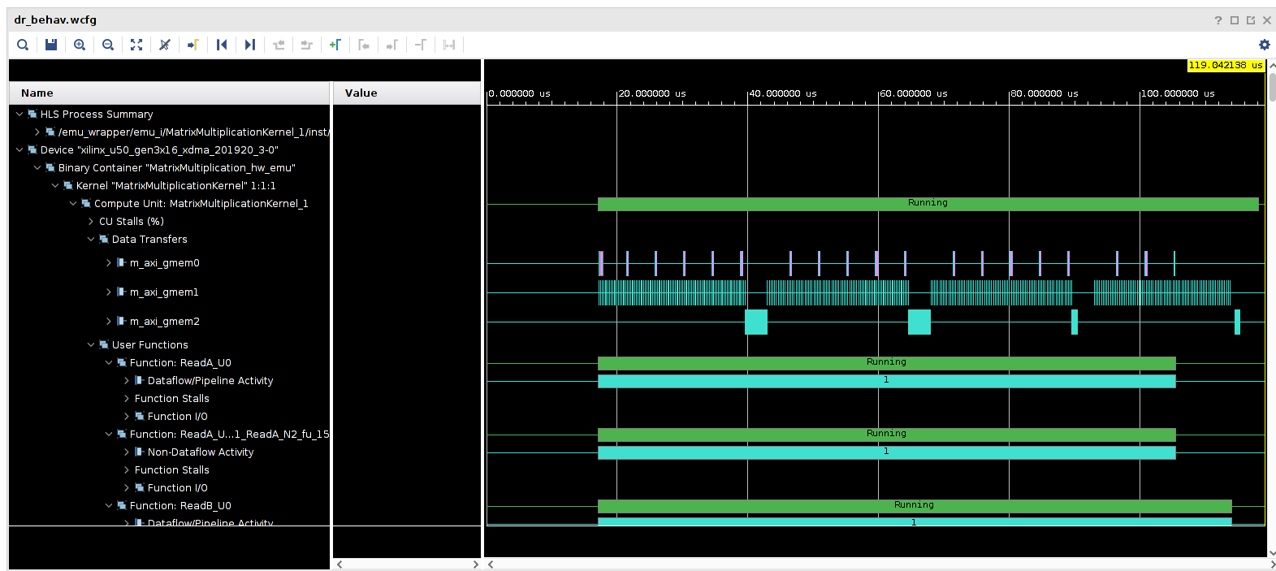
Different PE number - (N,M) = (16,4) input matrix size=80

Slide 43
PE Analysis
Function
Initialize ABuffer
Compute
WriteC
PARALLELISM_N = 16 , PARALLELISM_M = 4(Blue)
PARALLELISM_N = 8 , PARALLELISM_M = 2(Orange)

Slide 44
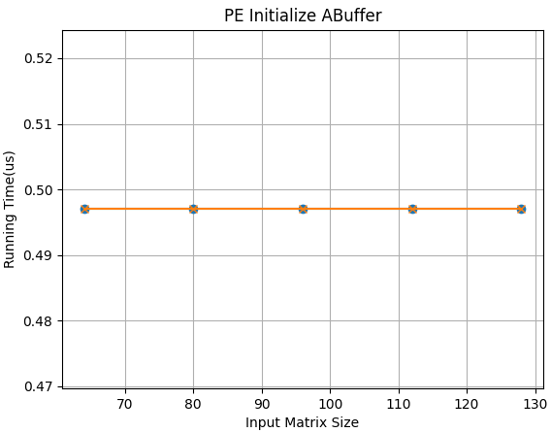
Initialize ABuffer

Slide 45
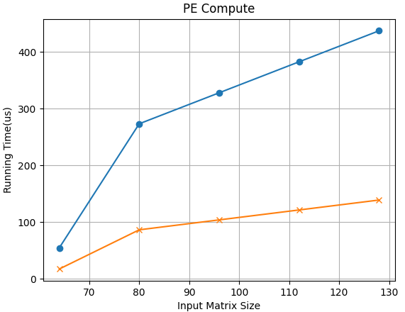
Compute

Slide 46
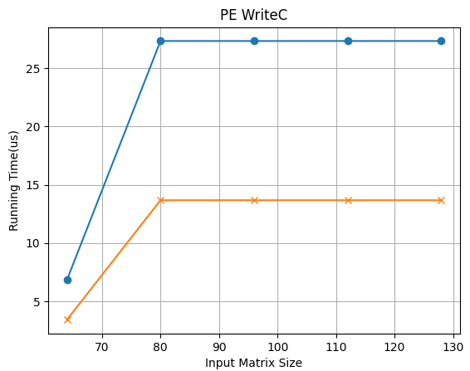
WriteC

Slide 47
Reference
[1] Z. Chen, Hardware Accelerator of Matrix Multiplication on FPGAs (Uppsala Universitet) p. 1
[2] J. d. F. Licht, G. Kwasniewski, T. Hoefler, Flexible Communication Avoiding Matrix Multiplication on FPGA with High-Level Synthesis https://spcl.inf.ethz.ch/Publications/.pdf/gemm-fpga.pdf
[3] 2022’s Final Project https://github.com/bol-edu/2022-spring-nthu/blob/main/Final/gemm_hls/Final/Group8_Final_Report.pdf

Slide 48
Thanks for listening!

